Slide 1
Animations and Animation Pane
There are 4 types of animations in Powerpoint: Entrance, Emphasis, Exit and Motion Paths animation.
Entrance – Make objects appear
Emphasis – Add effects to already visible objects
Exit – Make objects disappear
Motion Paths – Move objects along a predefined path
All of these are controlled in the Animation Pane.

Slide 2
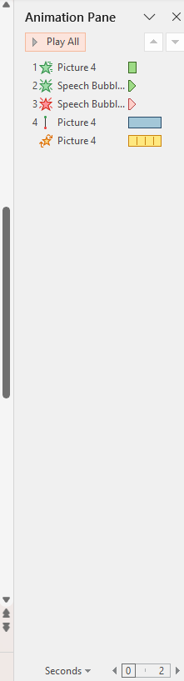
Animation Pane
The Animation Pane is found on the Animations Tab in the Advanced Animation section. It will open on the right side of screen showing all animations in the slide your in. It has many required features to control your animations:
  Rearrange: You can drag animations up or down to change the order they go on.
  Set Animation timing: Adjust start options(On click, With Previous, After Previous)
  Preview: You can click any animation in the Pane and preview it from that point and on.
  Remove: You can right click an animation to remove it.
It also shows in the bottom the time bar that shows when the animation starts and finish in seconds.

